Slide 1
Robot Operating System (ROS)
NICOLA BEZZO, MASOUD BASHIRI
Fall 2016
Autonomous Mobile Robots

Slide 2

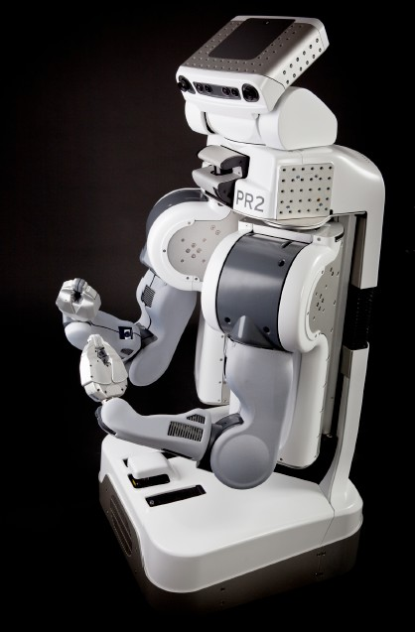


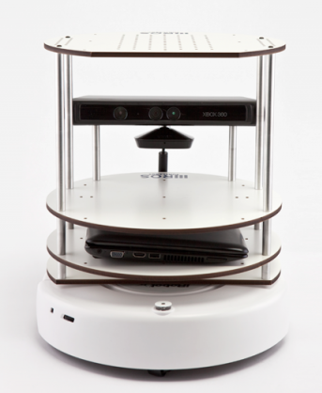
ROS is a flexible framework for writing robot software
100+ ROBOTS
100 SENSORS/ INTERFACES
2000+ LIBRARIES
http://www.ros.org
CODE REUSABILITY
Autonomous Mobile Robots

Slide 3
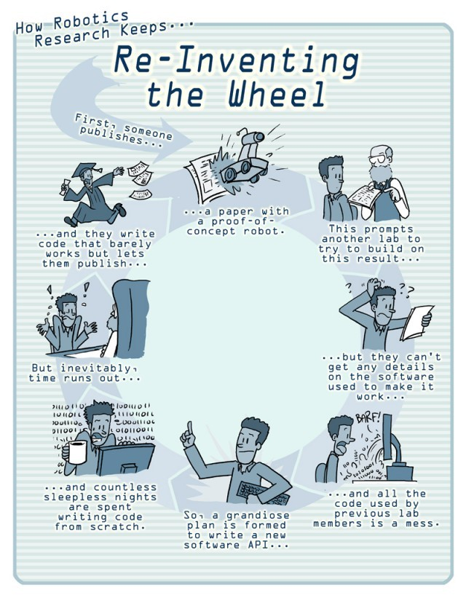

Slide 4
What is ROS?
A meta Operating System for Robots. As an OS, provides:
low-level device control
implementation of commonly-used functionality
message-passing between processes (they’re called nodes)
package management
Tools and libraries for development and running code across machines
Supports C++, Python and Lisp
experimental libraries for Java
ROS is not an actual OS! it is a middleware. It sits on top of an OS (Linux and Mac are officially supported).
IPC
App
App
ROS
App
App
UBUNTU
HARDWARE
Autonomous Mobile Robots

Slide 5
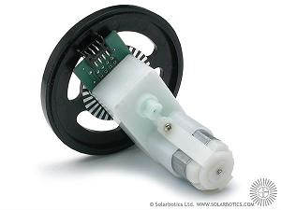
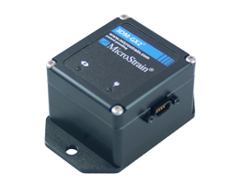
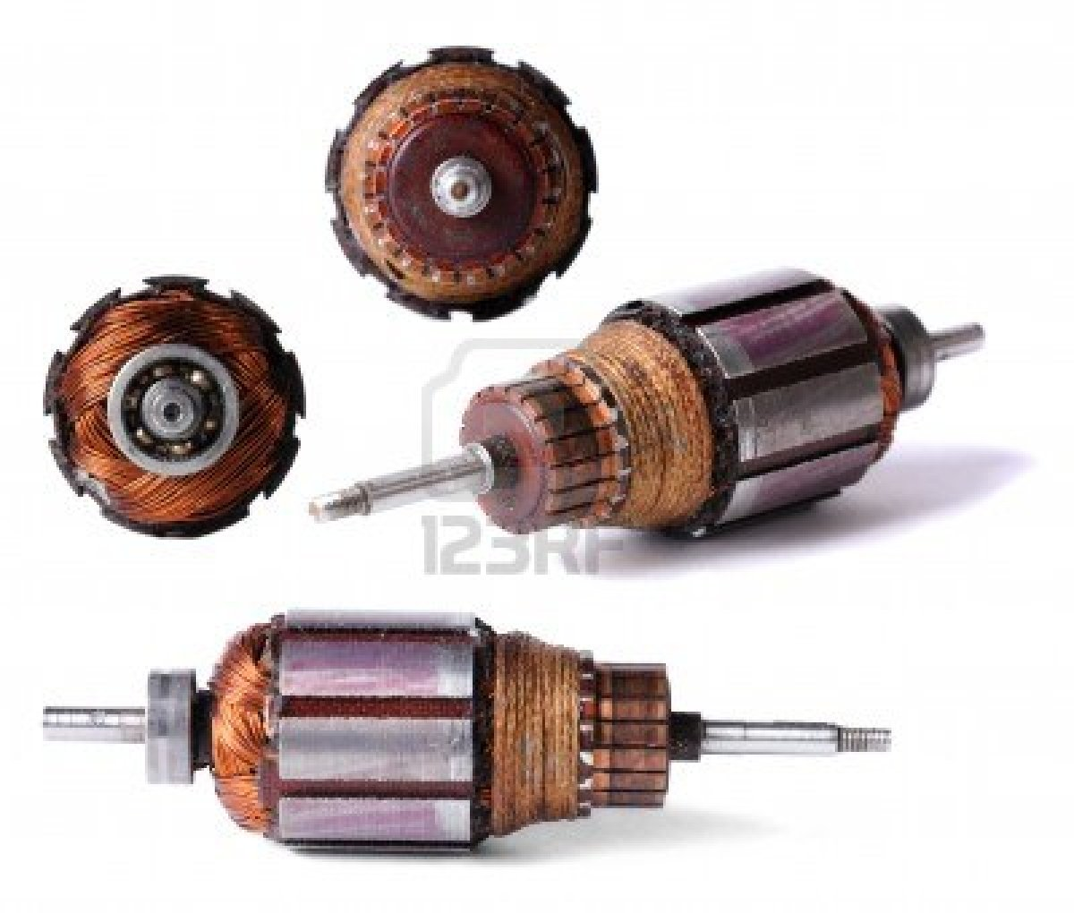
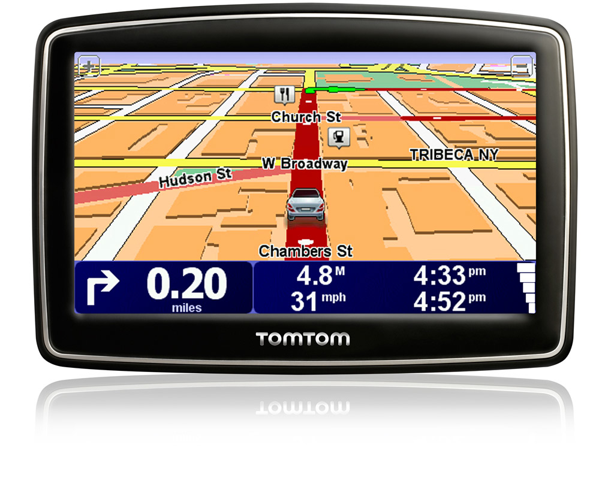
CPU
Operating System (Ubuntu 16.04)
ROS (Kinetic Kane)
2) Subscribe to GPS
1) Subscribe to TWIST
2) Advertise to TWIST
ROS Master
1) Advertise to GPS
3) Host + Port
PUB/SUB ARCHITECTURE
4) Topic Request
Controller Node
GPS Node
Motor
5) Topic Stream
ROS Drivers
SENSORS
ACTUATORS

Slide 6
ROS Computation Graph
Master
Provides name registration and look up to the nodes (Like a DNS Server).
Nodes
Are executable that use ROS to communicate with other nodes.
A ROS node is written with the use of a ROS client library, such as roscpp or rospy.
Messages
A ROS message is a data structure, comprising typed fields. Nodes communicate with each other by passing messages. (Structures defined in .msg files)
Topics
Each topic is a message bus that carries a certain type of message. Multiple nodes can subscribe and publish to a single topic. Also one node can subscribe and publish to many topics.
Autonomous Mobile Robots

Slide 7
ROS Computation Graph (Cont’d)
Services
ROS Services complements the subscriber/publisher communication model (Topics), by adding a synchronous request/reply model.
A service provider node offers a service under a name and a client node uses the service by sending the request message and awaiting the reply.
Bags
Bags are a format for saving and playing back ROS message data.
Example: Storing sensor data to be used later.
Autonomous Mobile Robots

Slide 8
Nodes
Master
Messages
Computation Graph
Services
Bags
Topics
Autonomous Mobile Robots

Slide 9
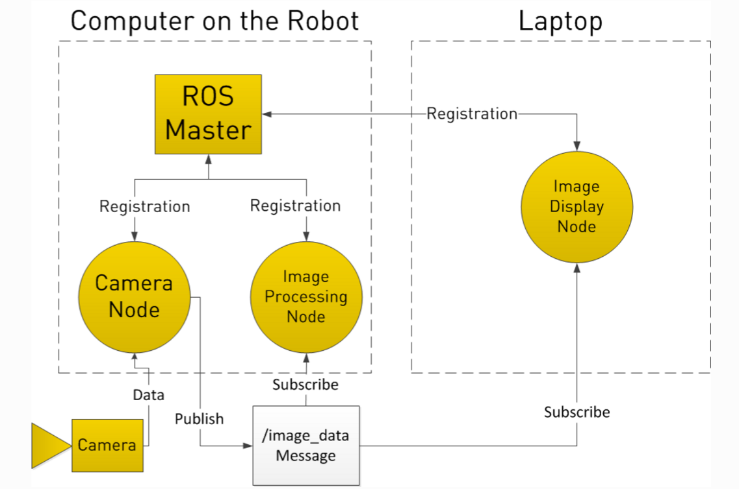
Example: Topics
Asynchronous “Stream-like” Communication
TCP/IP or UDP Transport
Strongly typed (.msg files), supports primitive datatypes and arrays
Multiple Publishers
Multiple Subscribers
credit: Clearpath Robotics
Autonomous Mobile Robots

Slide 10
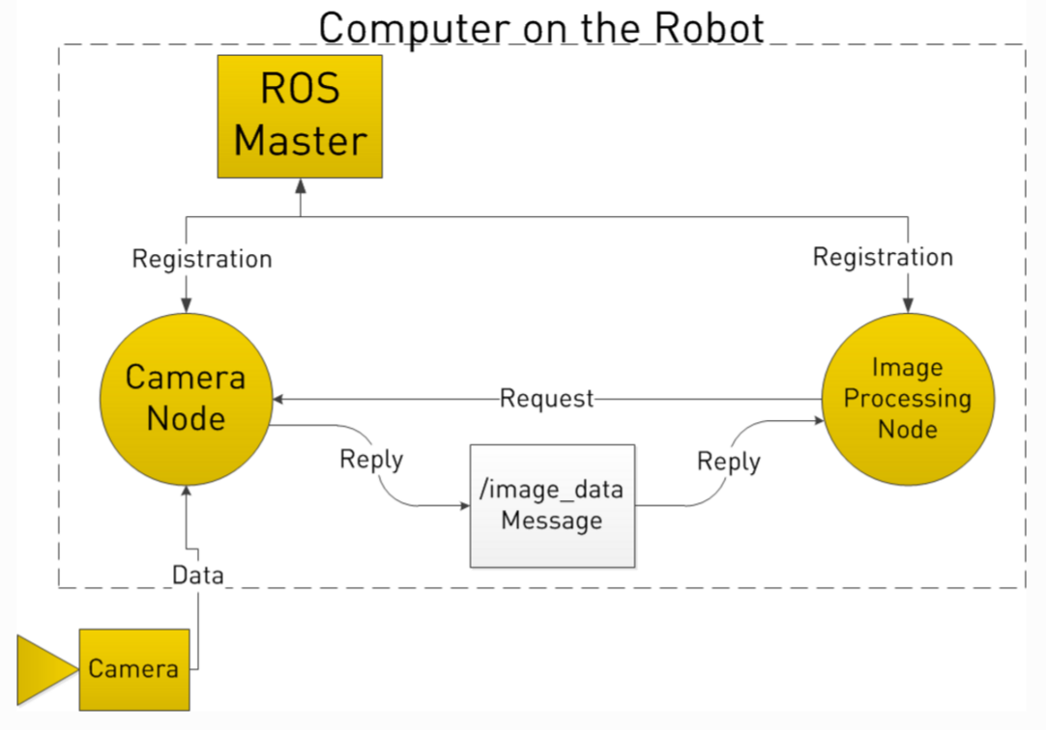
Example: Services
Synchronous “RPC-like” Communication
TCP/IP or UDP Transport
Strongly typed (.srv spec)
One Server
One or many clients
credit: Clearpath Robotics
Autonomous Mobile Robots

Slide 11
OPEN YOUR BOX
Autonomous Mobile Robots

Slide 12
Rules
Your group number is the number that you find on the Turtlebot and computers that you have received.
Assign a name to your turtlebot: that’s your group’s name
Every time there is a Lab (usually on Thursdays) you (at least a member from your group) must pick up your robot from Rice 240 and bring it down to Rice 120. Viceversa, at the end of each class, you’ll have to bring the equipment back to Rice 240.
Please remember to charge your turtlebot and laptops before each lab session to avoid delays during the lab.
You are allowed to use only your assigned robot and computers (i.e., you cannot use other groups equipment)
Three dedicated networks are available to connect laptops and turtlebots. The networks SSID are AMR 1, 2, and 3. These networks are up and running in Rice 240. Please don’t remove the routers from the room.
You are allowed to use the equipment at any time during the semester.
The equipment can be used only inside Rice Hall, preferably inside/around Rice 240

Slide 13
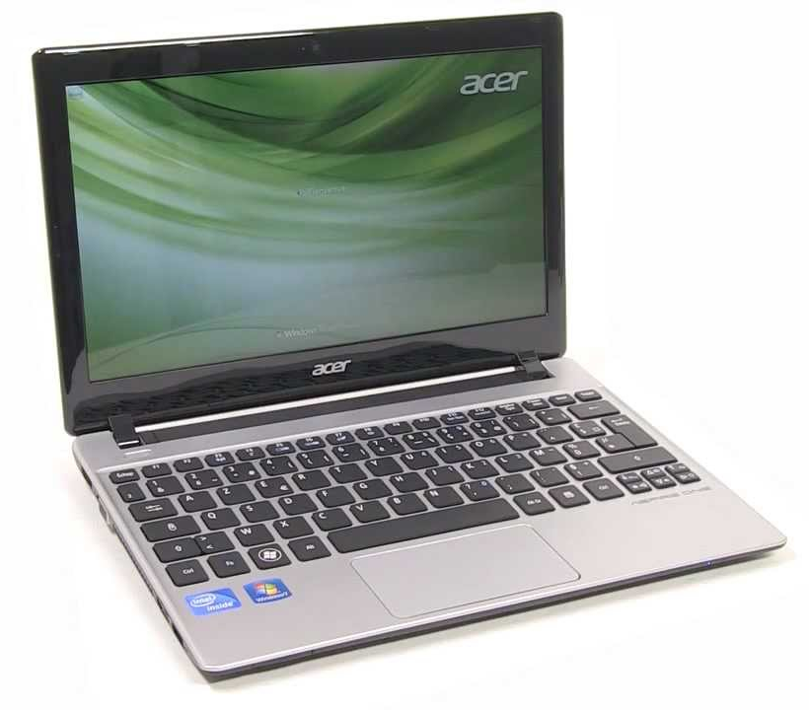
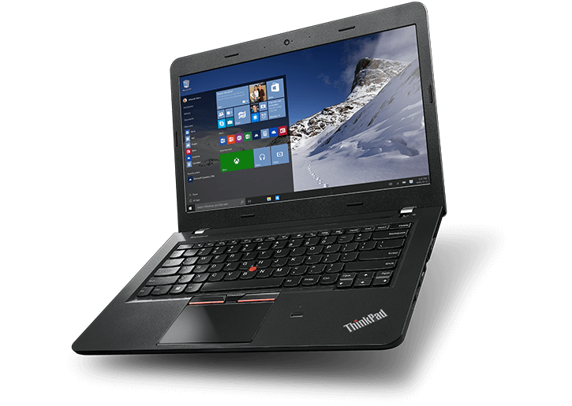
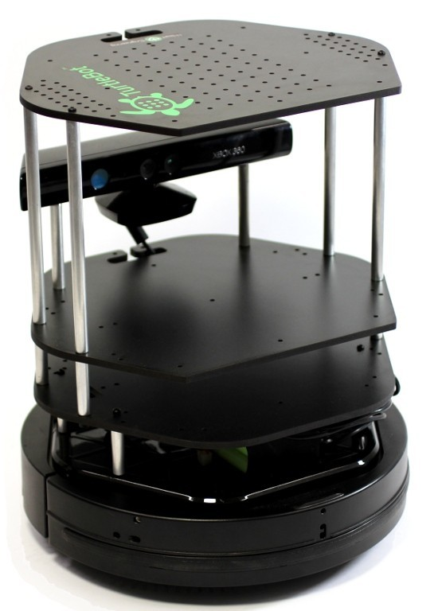
Communication
1)
2)
MASTER
ACER
ACER
SSH
LENOVO
LENOVO
Autonomous Mobile Robots

Slide 14
Connect to your TurtleBot
Turn on your turtlebot laptop and connect to a network as follows
1~3 connect to AMR1,
4~6 connect to AMR2,
7~10 connect to AMR3,
Turn on your workstation laptop (password=username) and connect to the same network
On the turtlebot laptop, open a terminal and type in ifconfig to find your IP. We will refer to this as IP_OF_TURTLEBOT
On the workstation laptop, open a terminal and type in ifconfig to find your IP. We will refer to this as IP_OF_PC
network password is turtlebot
Autonomous Mobile Robots

Slide 15
Network Configuration
On the workstation Laptop (Lenovo)
echo export ROS_MASTER_URI=http://IP_OF_TURTLEBOT:11311 >> ~/.bashrc
echo export ROS_HOSTNAME=IP_OF_PC >> ~/.bashrc
On the Turtlebot Laptop (Acer)
echo export ROS_MASTER_URI=http://localhost:11311 >> ~/.bashrc
echo export ROS_HOSTNAME=IP_OF_TURTLEBOT >> ~/.bashrc
Verify the connection
On the workstation Laptop, open a terminal and: rostopic list
Do you see a list of topics? If not, verify that ROS_HOSTNAME is set properly on the turtlebot laptop
Autonomous Mobile Robots

Slide 16
How to SSH into your Turtlebot
ssh turtlebot@[ip_of_turtlebot]
The password is 'turtlebot'
Now you have a secure shell connection to your acer laptop.
In the terminal type in: roslaunch turtlebot_bringup minimal.launch
This roslaunch command runs a series of nodes in your turtlebot that allow you to get data from IMU, encoders, cliff sensors, bumper switches and send commands to the actuators
If you need another terminal connected to turtlebot you need to repeat the ssh procedure in a new terminal

Slide 17
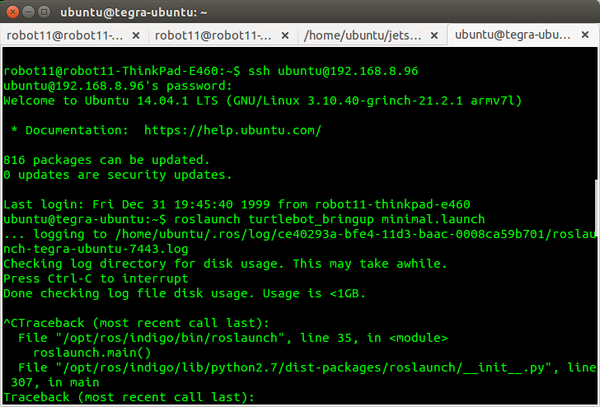
Please note that in the example below the username is 'ubuntu' whereas in your case it should be 'turtlebot'.

Slide 18
Some Command-Line Tools
Roscore
Starts up ROS Master, ROS Parameter Server and RosOut logging node.
Rosbag
Used for recording and playing data (from topics)
Rospack
helps you find a package path. Usage: rospack find [package_name]
Roscd
Allows you to cd directly to a package
Also rosls shows the files and folders inside a package
Autonomous Mobile Robots

Slide 19
Some Command-Line Tools (Cont’d)
rosrun
allows you to run an executable in an arbitrary package.
roslaunch
launches a set of nodes from an XML configuration file (.launch file) and includes support for launching on remote machines.
rostopic
displays run-time information about topics and also lets you print out messages being sent to a topic.
rosparam
enables getting and setting parameter server values from the command-line.
Autonomous Mobile Robots

Slide 20
Some Command-Line Tools - Graphical
rqt_plot
plots numerical data on a ROS topic over time.
rqt_graph
displays an interactive graph of ROS nodes and topics.
rqt_bag
is a graphical tool for viewing data in ROS bag files.
Autonomous Mobile Robots

Slide 21
Command tools: rostopic
rostopic echo [topic_name] //see the messages being publish in a specific topic
rostopic list //see a list of available topics
rostopic hz [topic_name] //see the rate of a topic
rostopic bw [topic_name] //see the bandwidth usage of a
topic

Slide 22
Publish to a topic in command line
rostopic pub -r [rate] [topic_name] [msg] //publish to a topic
Example: Let's make the robot move by publishing a Twist
Message to the '/cmd_vel/input/navi' that specifies a linear
Velocity of 0.1(m/s), play around with the parameters and observe the behavior of turtlebot.
rostopic pub -r 10 /cmd_vel_mux/input/navi geometry_msgs/Twist '{linear: {x: 0.1,y: 0.0,z: 0.0},angular: {x: 0.0,y: 0.0,z: 0.0}}'

Slide 23
Use rosbag and rqt_bag to record and playback/
plot topic data
First make a directory to save your bag files
mkdir ~/bagfiles
Now let's start recording a topic, for examle /odom
Rosbag record /odom
Hit ctrl+c to stop the recording process now use rqt_bag
To playback and plot the recorded data
rqt_bag [your_bag_file]

Slide 24
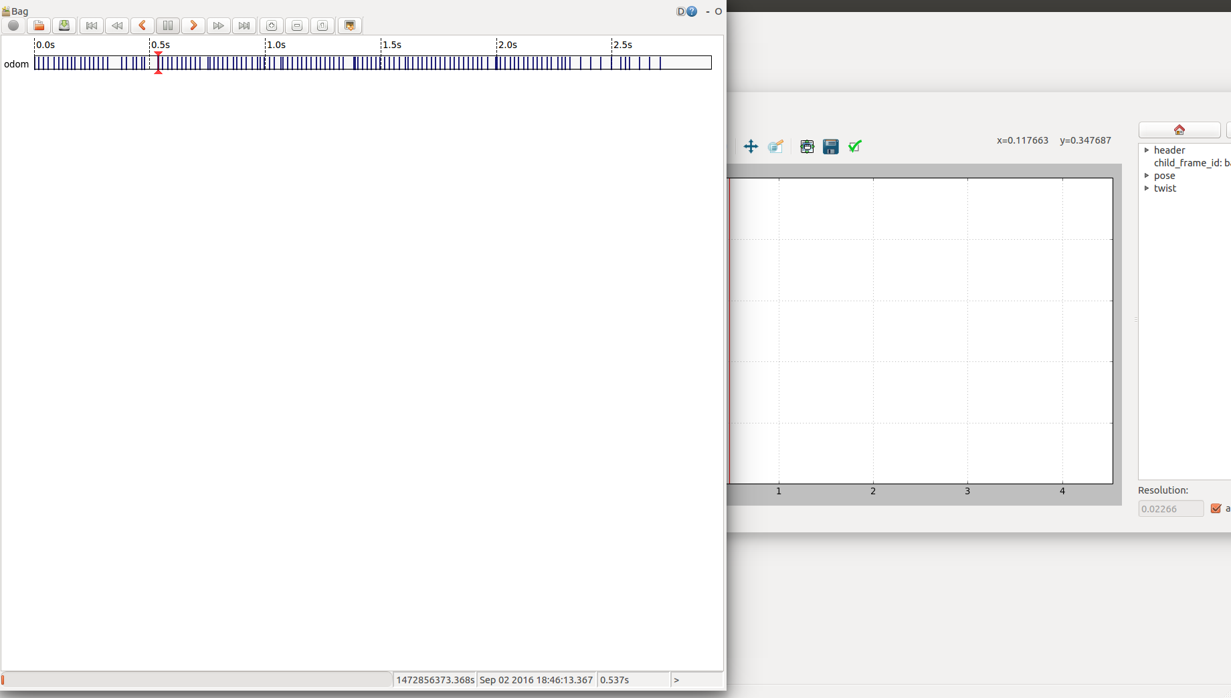
Use rosbag and rqt_bag to record and playback/plot topic data

Slide 25
LAB#2
Open your Box and Turn everything ON
Connect the Acer to the turtlebot base using the USB cable
On your Lenovo, Open a terminal and ssh into the acer laptop by typing in:
ssh turtlebot@[IP_OF_TURTLEBOT]
The password is turtlebot
In the connected terminal launch the minimal.launch by typing in:
roslaunch turtlebot_bringup minimal.launch
Verify your connection to the master:
In another terminal run rostopic list
You should be able to see a list of topics now, if not check your .bashrc file
Open another terminal on Lenovo and ssh again
Now run the ROS joystick node to publish joystick data for the joystick teleop exercise
rosparam set joy_node/dev “/dev/input/js1”
rosrun joy joy_node
Leave these terminals running and open new terminals when you need to run other commands
Listen to joystick data: rostopic echo joy

Slide 26
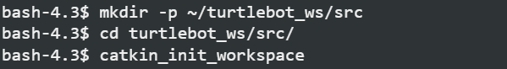
Catkin Package Management Tool
Catkin is a package management tool developed for ROS users that makes package management easier.
Let’s create a catkin workspace and build our first package
Open a terminal
Autonomous Mobile Robots

Slide 27
Create and build your first package
Let’s create our first package and build it
cd ~/turtlebot_ws/src
catkin_create_pkg turtlebot_1 roscpp rospy geometry_msgs sensor_msgs
cd ../
catkin_make
Next step is sourcing the setup file,
Source ~/turtlebot_ws/devel/setup.bash
after running this command, ROS will be able to find your catking package(s)
Autonomous Mobile Robots

Slide 28
Example Code: turtlebot_turn.cpp
#include "ros/ros.h"
#include <geometry_msgs/Twist.h>
#include <sensor_msgs/Imu.h>
void imuCallback(const sensor_msgs::Imu::ConstPtr& data)
{
ROS_INFO("Angular Velocity = %f", data->angular_velocity.z);//print out the angular velocity
}
int main(int argc, char **argv)
{
ros::init(argc, argv, "turtlebot_turn");
ros::NodeHandle nh;
ros::Publisher vel_pub;
vel_pub = nh.advertise<geometry_msgs::Twist>("/cmd_vel_mux/input/navi", 1, true);
ros::Subscriber sub = nh.subscribe("/mobile_base/sensors/imu_data", 10, imuCallback);
ros::Rate loop_rate(10);
int count = 0;
geometry_msgs::Twist vel;
vel.linear.x = 0;//linear velocity(m/s)
vel.angular.z = 1.0;//angular velocity(rad/s)
while (ros::ok())
{
vel_pub.publish(vel);
ros::spinOnce();
loop_rate.sleep();
++count;
if(count==20)
vel.angular.z = 0;
}
return 0;
}
Autonomous Mobile Robots

Slide 29
CMakeLists, Build and Run
Locate the ‘Cmakelists.txt’ file in your package
Copy the following lines to the end of your CMakeLists.txt file
include_directories(include ${catkin_INCLUDE_DIRS})
add_executable(turtlebot_turn src/turtlebot_turn.cpp)
target_link_libraries(turtlebot_turn ${catkin_LIBRARIES})
In a terminal build the package and source the setup file
cd ~/turtlebot_ws
catkin_make
source devel/setup.bash
Now you should be able to run your first node!
rosrun turtlebot_1 turtlebot_turn
Autonomous Mobile Robots

Slide 30
Lab Assignment #1
Joystick teleoperation
Autonomous wandering with bumper switches: use the 3 bumper sensors to navigate the robot around at constant input speed. As soon as an obstacle is detected, turn the robot toward a different direction and keep going until it bumps into another obstacle
Cruise control, variable speed. Use odom data and implement a PID on the speed. Maintain 0.3m/s then 0.5m/s and finally 0.6m/s. Implement the cruise control behavior on top of the autonomous wandering behavior in 2 (i.e., reach and maintain a desired speed until the robot bumps into an obstacle).
extra if time permits: while in autonomous wandering, add joystick commands that take over and switch between wondering and teleop behaviors. Typically: while a joystick key is pressed the robot enters into teleop mode and once it is released the robot continue on its autonomous wandering behavior. Assign cruise control speeds to the following buttons on the joystick: green button = 0.3m/s; blu = 0.5m/s; yellow = 0.6m/s; red = stop (0m/s)
extra: build a map using bumper data and encoder data. Collect data and plot the map.
extra: Same as 3. but use encoder “ticks” data and calculate speed.

Slide 31
Useful Links
Ros Wiki Turtlebot Page
Catkin Tutorial
The Turtlebot Stack on Github
Turtlebot Demos
UNIX Tutorial for Beginners
Turtlebot Guide and Support
Autonomous Mobile Robots

